Slide 1

Wedding Cakes by Eela
Cakes by Eela is proudly run by Iqra(Eela) with the support of her husband while raising their two children. What started as making cakes and desserts for family and friends soon became a thriving business built on quality, creativity, and attention to detail. Whether it's a birthday, wedding, or any special occasion, our goal is to bake delicious, beautiful cakes that bring people together and make every celebration unforgettable.

Slide 2
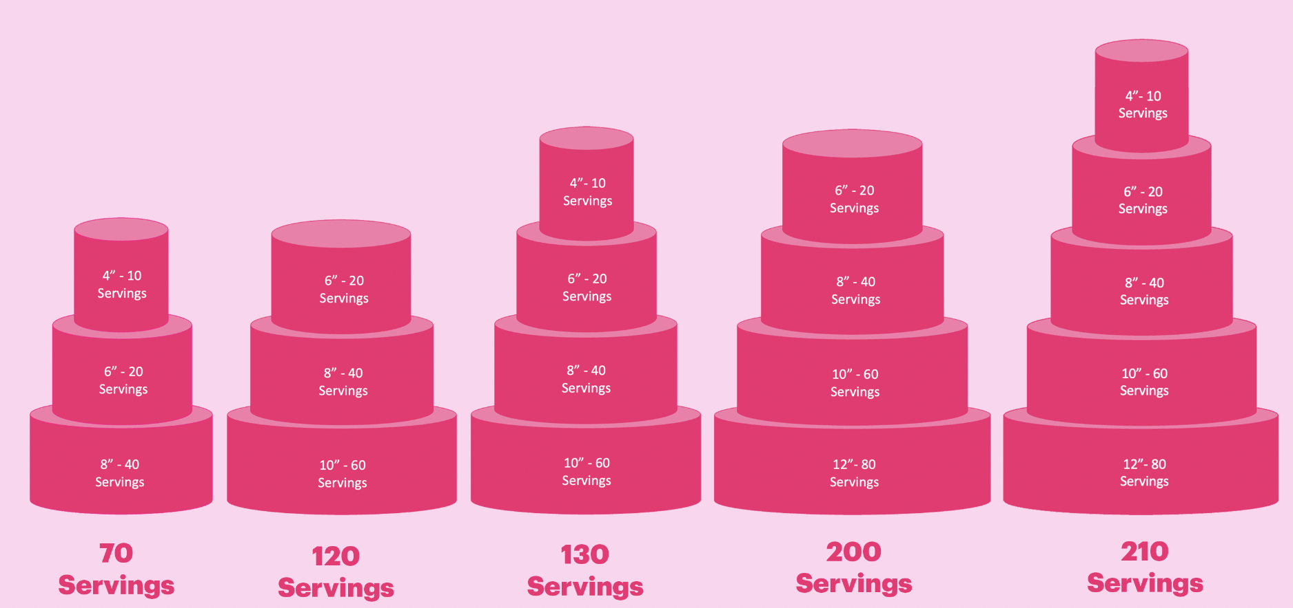
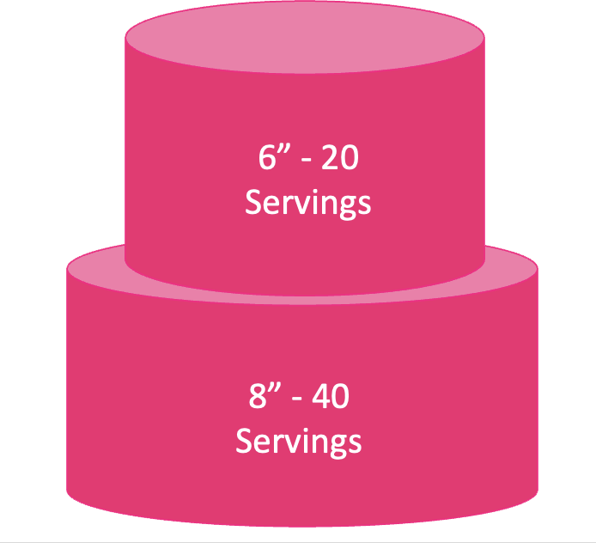


Slide 3
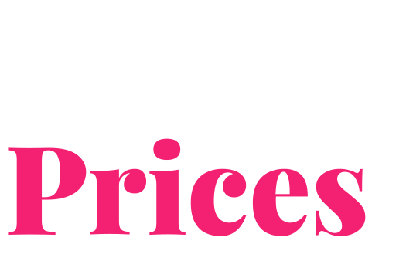
Portion size: traditional finger slice 1” x 1” x 5”
Design Level | Cost Per Slice | 60 Servings | 70 Servings | 120 Servings | 130 Servings | 210 Servings | 300 Servings
Simple A simple yet elegant Wedding Cake. This design does not feature florals. Some examples include a ribbed base, a pearl base, or a smooth base. | $5 | $300 | $350 | $600 | $650 | $1,050 | $1,500
Moderately Complexed The most popular of the 3. These designs include grouped floral arrangements, creating a timeless composition. | $6 | $360 | $420 | $720 | $780 | $1,260 | $1,800
Complexed Consisting of detailed timely features; this design can include a waterfall of florals, intricate details and an array of materials. | $7 | $420 | $490 | $840 | $910 | $1,470 | $2,100

Slide 4

We offer a box of 4 sample cupcakes for $30 (excluding delivery). If you choose to proceed with a wedding cake, this is deducted from the final cost of the cake (excluding delivery).
Collection is also available from our location at Beveridge, 3753.
We also offer our standard celebration cake flavours which you can find on our website.
These flavours can be mixed and matched
Sponge Flavour | Filling Flavour
Vanilla | Vanilla Buttercream & Raspberry Jam
Chocolate | Chocolate Buttercream
Pineapple | Pineapple Buttercream & Fresh Pineapples
Strawberry | Strawberry Buttercream & Fresh Strawberries
Coconut | Vanilla Buttercream

Slide 5
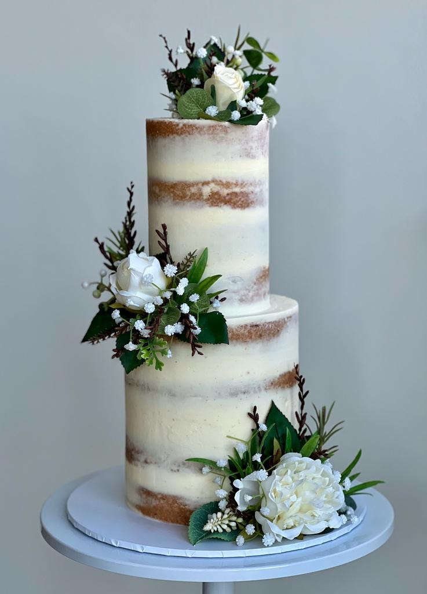
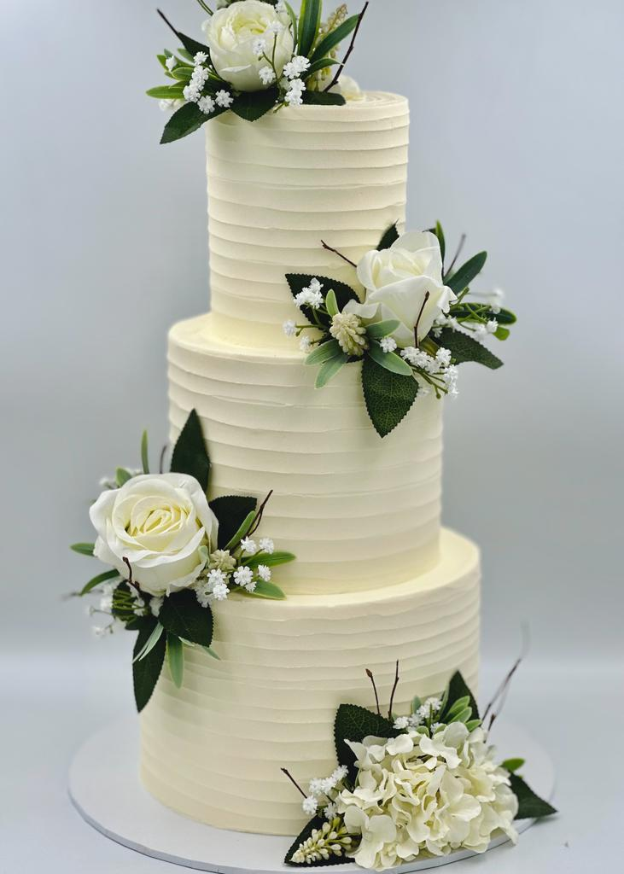
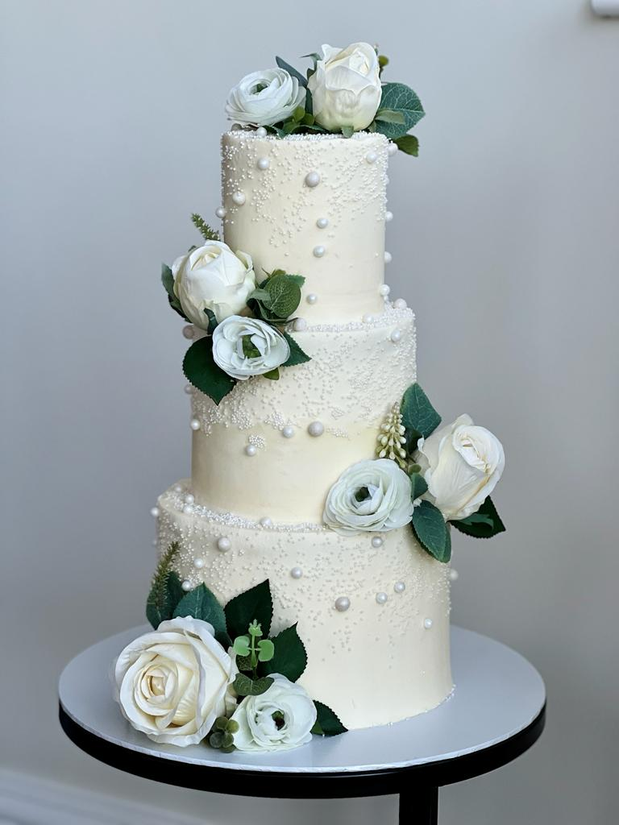
Moderately complexed

Slide 6
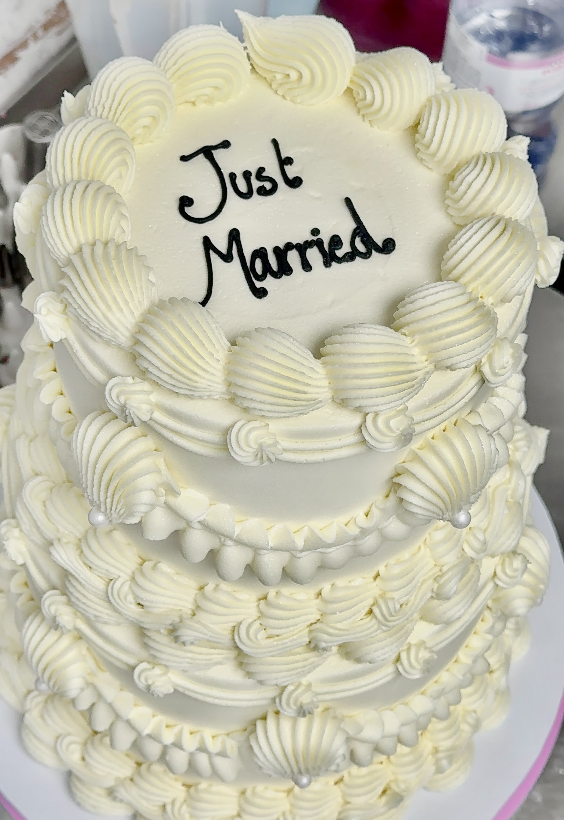
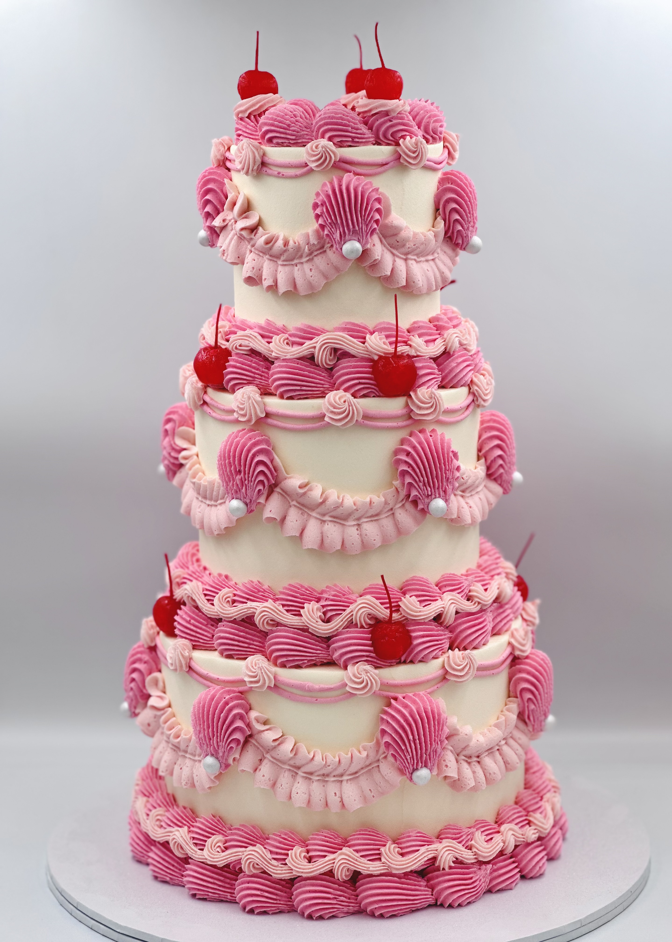
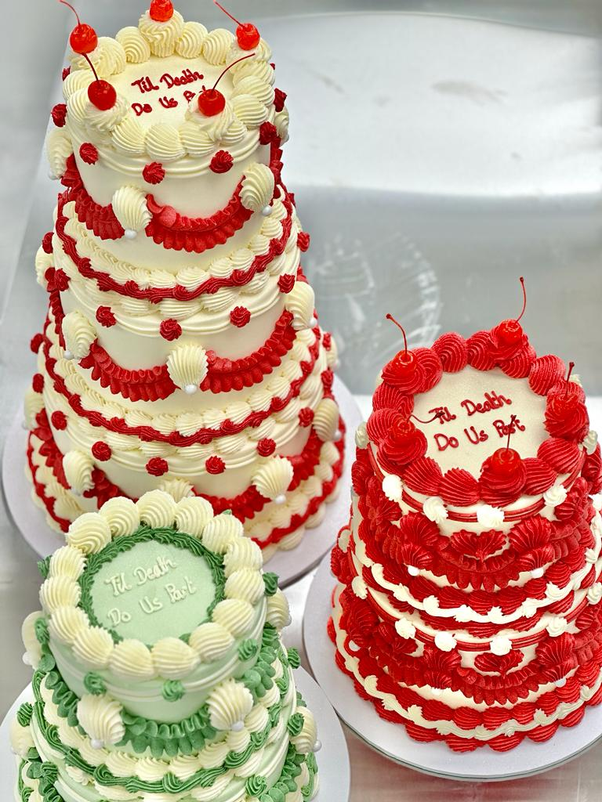
Moderately complexed

Slide 7
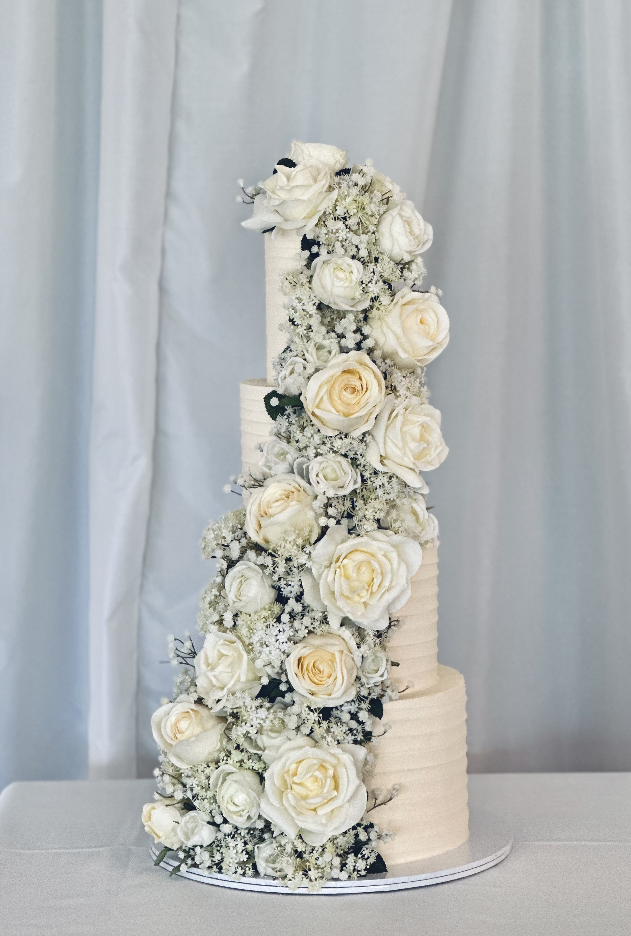
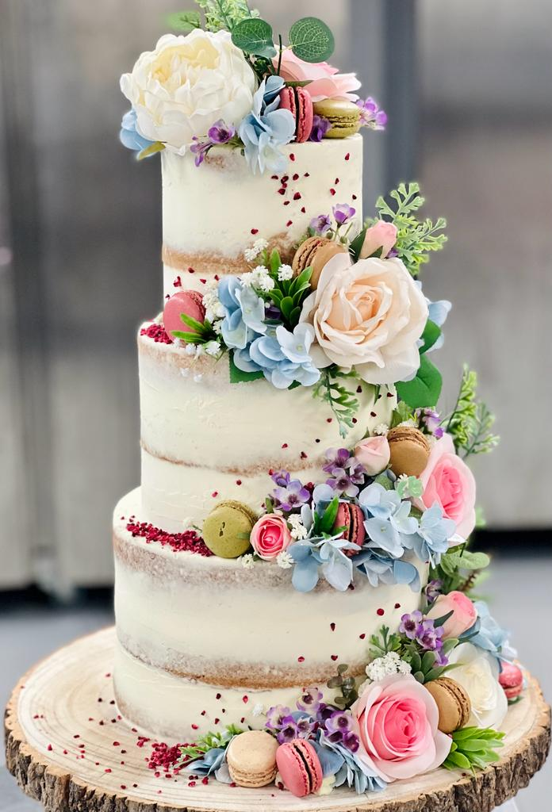
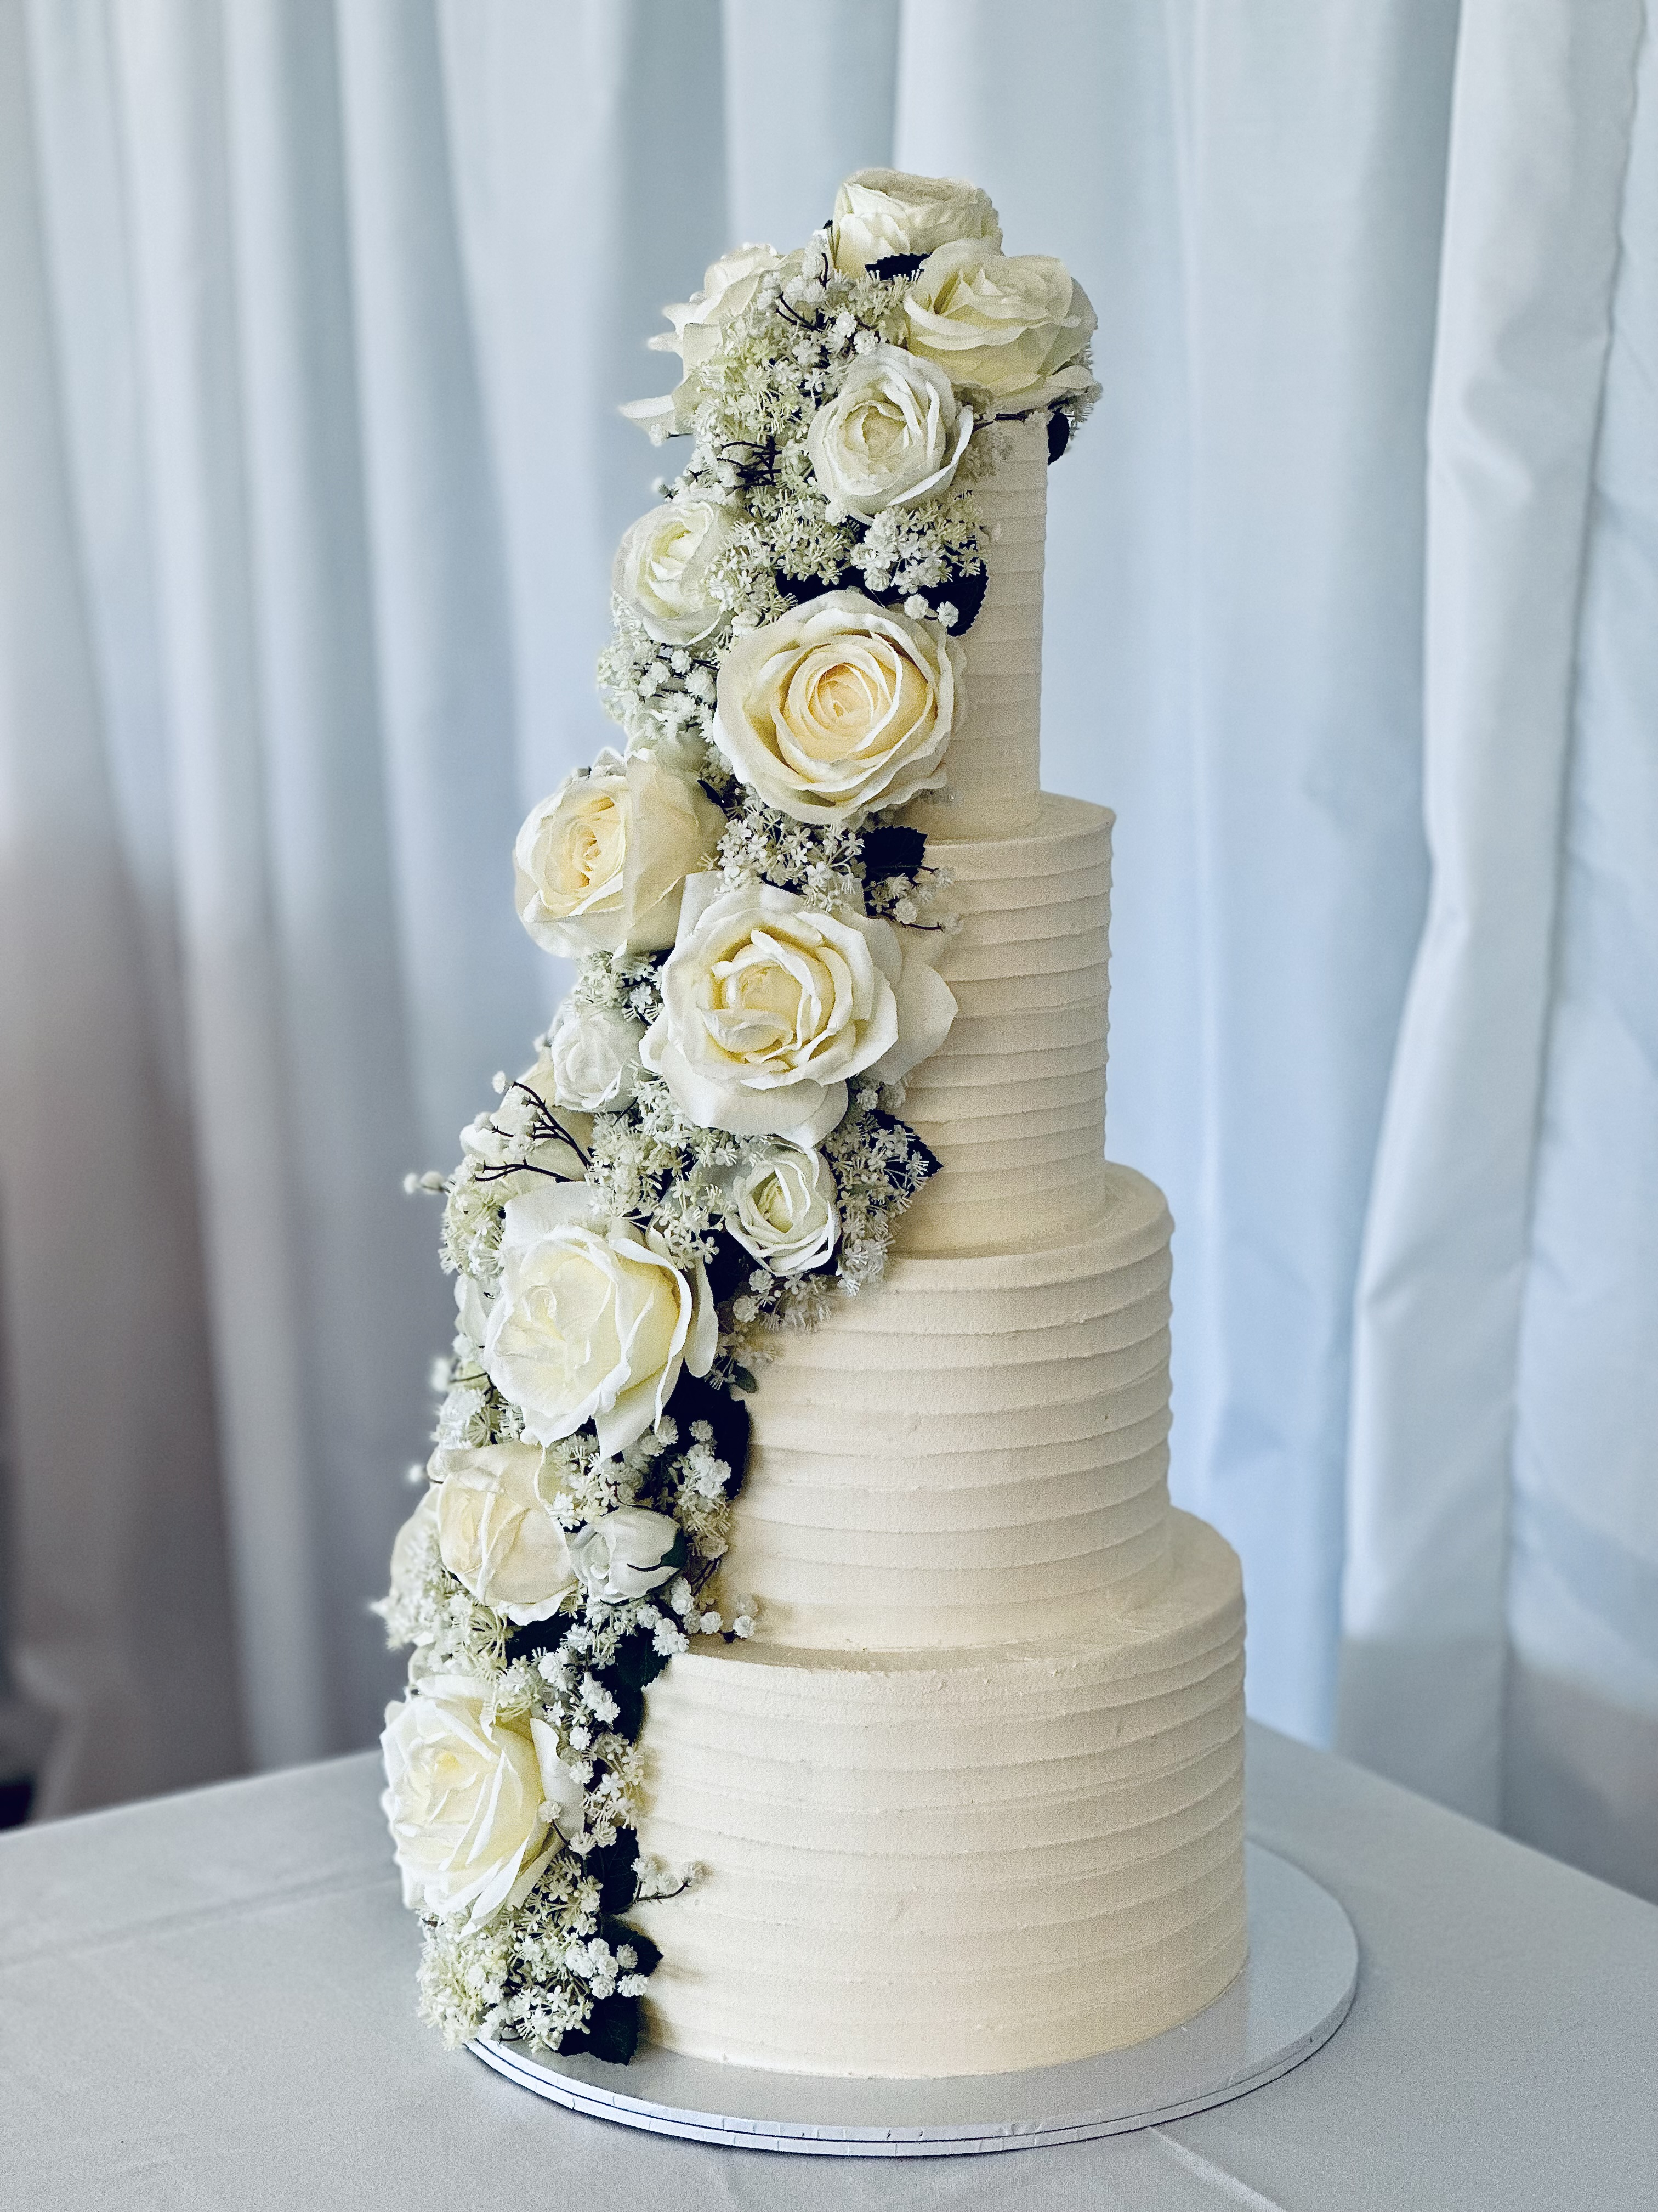
Complexed

Slide 8
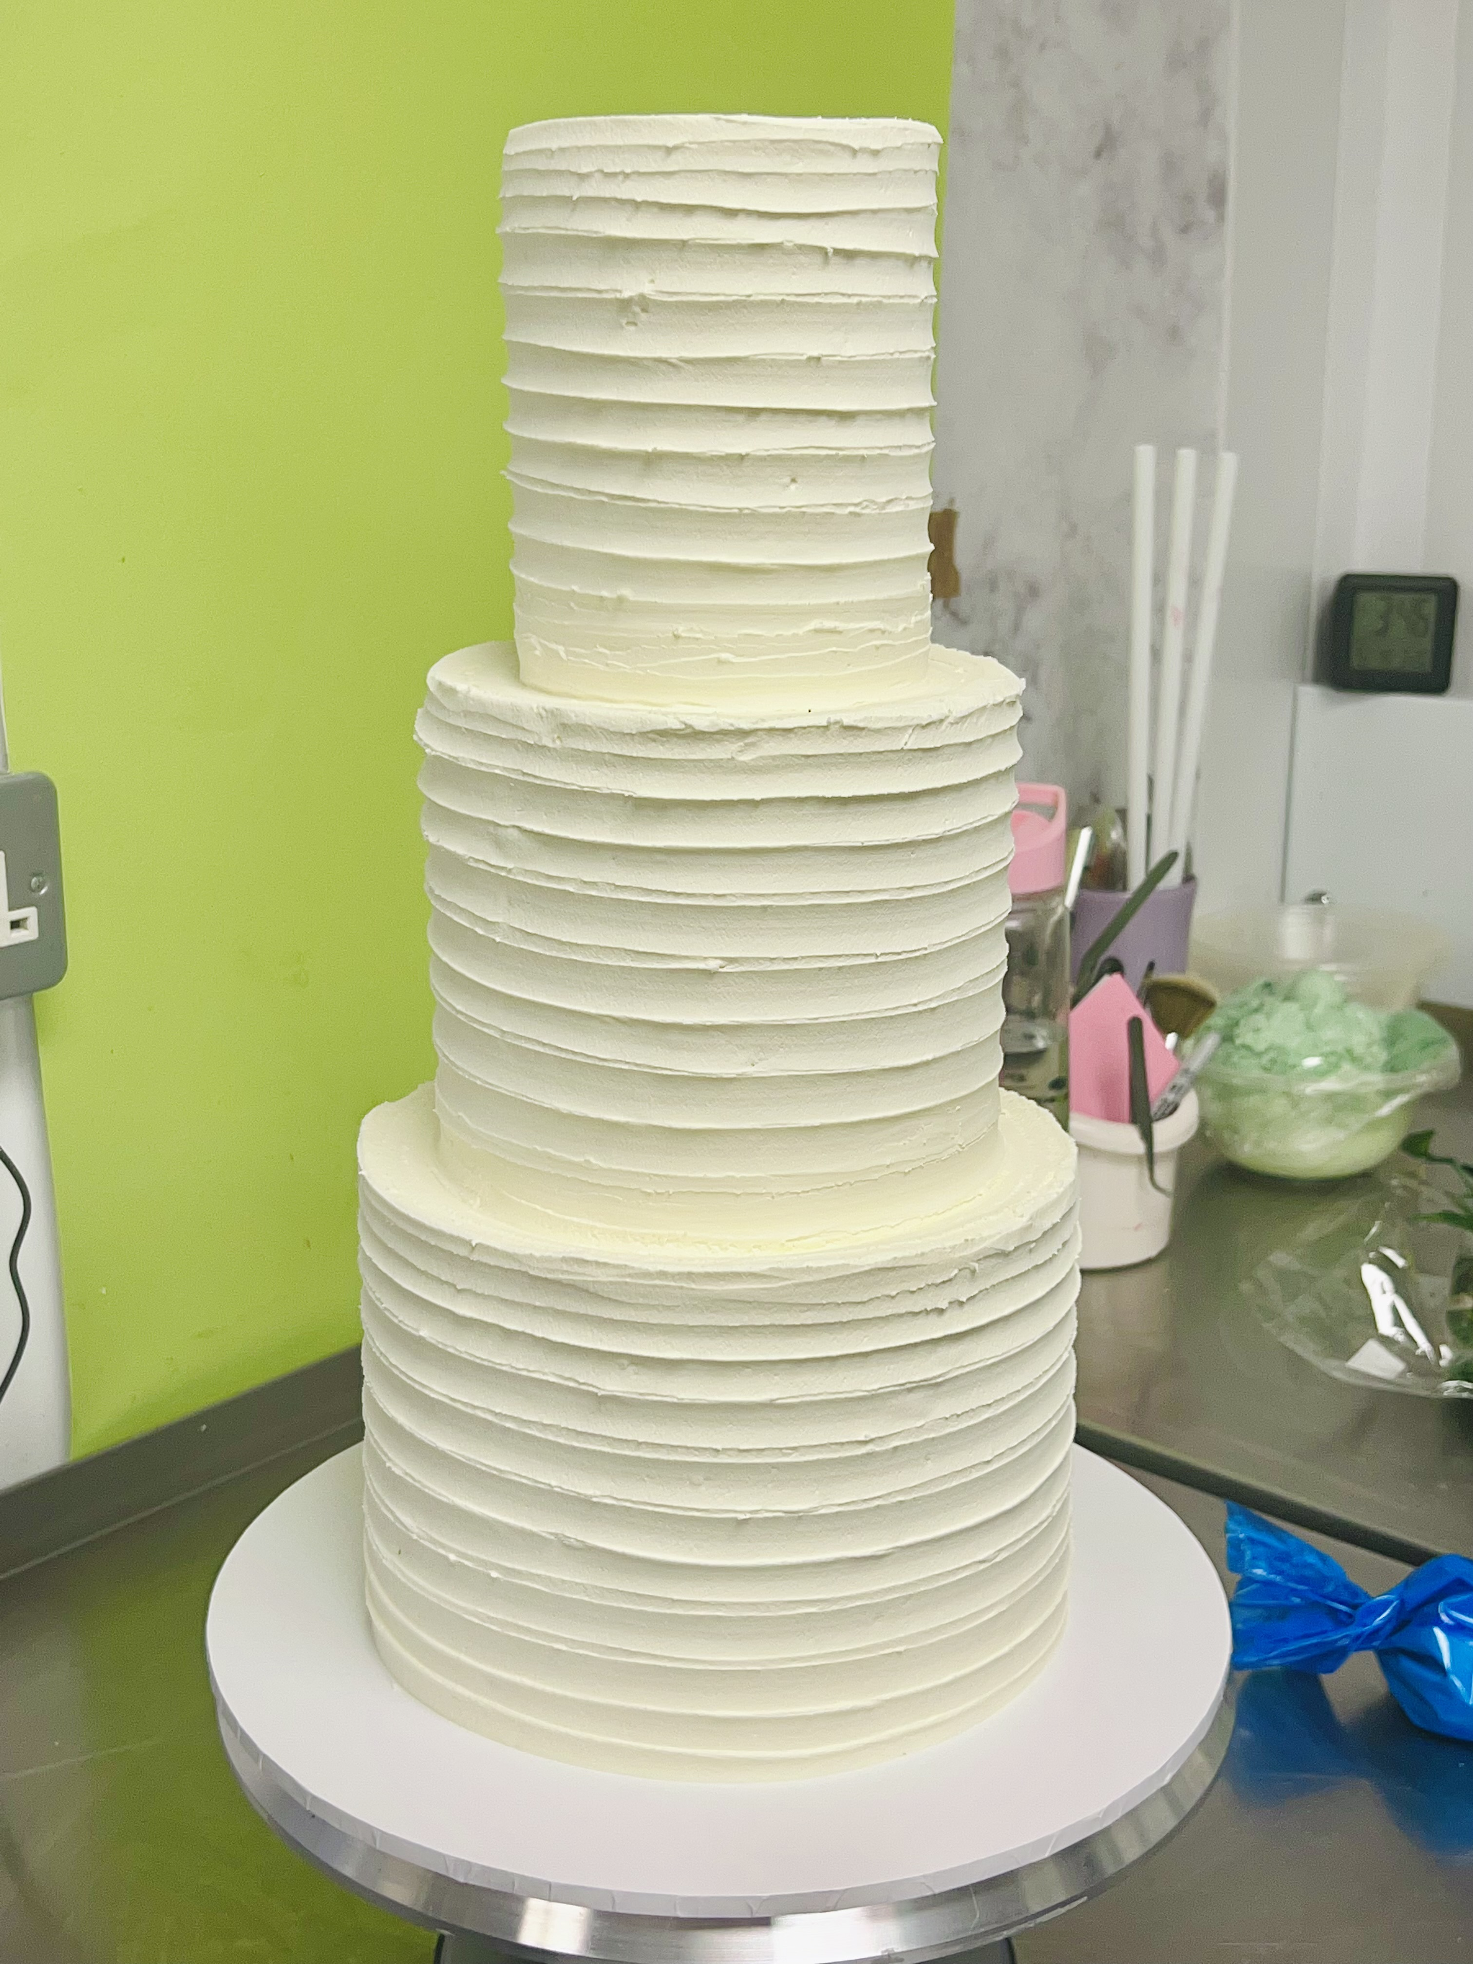
Simple

